Slide 1
Quick Sort
Quick sort is also called partition-exchange sort. It was developed by tiny hoare in 1959 and published in 1961.
It is a faster and highly efficient sorting algorithm.

Slide 2

We can use centre element as a Pivot element

Slide 3
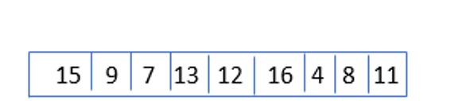
Smallest element
Largest element
Left side element
Right side element
Pivot Element

Slide 4
arr
i
Pivot
J
i value increment
And j value decrement every time
Conditions
While(arr[i]<piviot){
i++;
}
While(arr[j]>piviot){
J--;
}

Slide 5
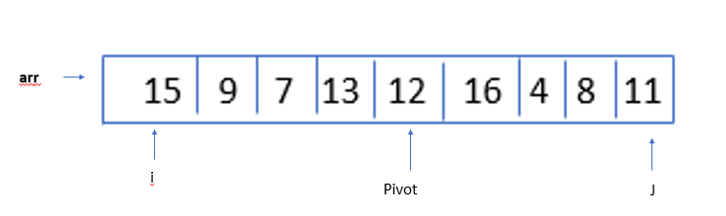
For e.g
That condtion runs when
While(i<=j)
While(15<12){
i++
}
While(11>12){
j--
}
Cond itions is false then swap the number

Slide 6
After swap increment i value and decrement j value and compare value again with pivot value.

Slide 7
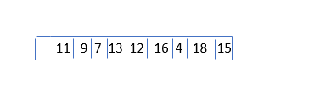
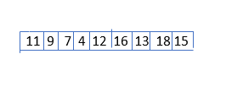
i
piviot
j

Slide 8
Left side
Right side
This is list 1
Less than pivot element
This is list 2
Greater than pivot element

Slide 9
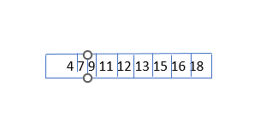
Again this process is apply same from left side list and right side list.
Every Time 1-1 number short and at last one sort list is present.
We can see in the program

Slide 10
Advantages of Quick Short
Fast and efficient
Time complexity
Space complexity

Slide 11
Disadvantages of Quick sort
Worst-case time complexity
Worst cases affect the performance of the quick sort.
Selecting a nearly sorted array can also result in StackOverFlowException

